Slide 1
Deformation Matrix and Spatial Reasoning
John R. Williams and Abel Sanchez
MIT 1.00

Slide 2




Idenity
$$\left\{\begin{matrix}x^{′} \\ y^{′}\end{matrix}\right\}=\left[\begin{matrix}1 & 0 \\ 0 & 1\end{matrix}\right]\left\{\begin{matrix}x \\ y\end{matrix}\right\}$$
$$\left(x,y \right)$$
$$\left(x^{′},y^{′}\right)$$
$$θ$$

Slide 3



Translate a Point
$$\left\{\begin{matrix}x^{′} \\ y^{′}\end{matrix}\right\}=\left[\begin{matrix}1 & 0 \\ 0 & 1\end{matrix}\right]\left\{\begin{matrix}x^{} \\ y^{}\end{matrix}\right\}+\left\{\begin{matrix}t_{x} \\ t_{y}\end{matrix}\right\}$$
$$\left(x,y \right)$$
$$t_{x}$$
$$\left(x^{′},y^{′}\right)$$
$$θ$$

Slide 4



Rotate a Point
$$\left\{\begin{matrix}x^{′} \\ y^{′}\end{matrix}\right\}=\left[\begin{matrix}\cos{θ} & −sin{θ} \\ \sin{θ} & \cos{θ}\end{matrix}\right]\left\{\begin{matrix}x^{} \\ y^{}\end{matrix}\right\}$$
$$\left(x^{′},y^{′}\right)$$
$$θ$$
$$\left(x,y \right)$$

Slide 5

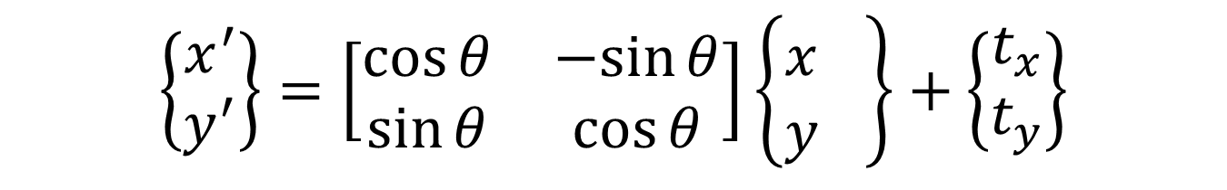

Rotate a Point and Translate it
$$\left\{\begin{matrix}x^{′} \\ y^{′}\end{matrix}\right\}=\left[\begin{matrix}\cos{θ} & −sin{θ} \\ \sin{θ} & \cos{θ}\end{matrix}\right]\left\{\begin{matrix}x^{} \\ y^{}\end{matrix}\right\}+\left\{\begin{matrix}t_{x} \\ t_{y}\end{matrix}\right\}$$
$$\left(x^{′},y^{′}\right)$$
$$t_{x}$$
$$\left(x^{′},y^{′}\right)$$
$$θ$$
$$\left(x,y \right)$$

Slide 6

Translate a Point
$$\left\{\begin{matrix}x^{′} \\ y^{′} \\ 1\end{matrix}\right\}=\left[\begin{matrix}1 & 0 & t_{x} \\ 0 & 1 & 0 \\ 0 & 0 & 1\end{matrix}\right]\left\{\begin{matrix}x \\ y \\ 1\end{matrix}\right\}$$
$$\left(x,y \right)$$
$$t_{x}$$
$$\left(x^{′},y^{′}\right)$$
$$θ$$

Slide 7




Translate a Point
$$\left\{\begin{matrix}x^{′} \\ y^{′} \\ 1\end{matrix}\right\}=\left[\begin{matrix}1 & 0 & t_{x} \\ 0 & 1 & t_{y} \\ 0 & 0 & 1\end{matrix}\right]\left\{\begin{matrix}x \\ y \\ 1\end{matrix}\right\}$$
$$\left(x^{′},y^{′}\right)$$
$$\left(x,y \right)$$
$$t_{x}$$
$$t_{y}$$

Slide 8



Rotate + Translate
$$\left\{\begin{matrix}x^{′} \\ y^{′} \\ 1\end{matrix}\right\}=\left[\begin{matrix}\cos{θ} & −\sin{θ} & t_{x} \\ \sin{θ} & \cos{θ} & t_{y} \\ 0 & 0 & 1\end{matrix}\right]\left\{\begin{matrix}x \\ y \\ 1\end{matrix}\right\}$$
$$t_{x}$$
$$\left(x^{′},y^{′}\right)$$
$$θ$$
$$\left(x,y \right)$$

Slide 9

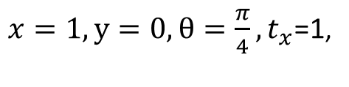
Rotate + Translate
$$\left\{\begin{matrix}x^{′} \\ y^{′} \\ 1\end{matrix}\right\}=\left[\begin{matrix}\cos{θ} & −sin{θ} & t_{x} \\ \sin{θ} & \cos{θ} & t_{y} \\ 0 & 0 & 1\end{matrix}\right]\left\{\begin{matrix}x \\ y \\ 1\end{matrix}\right\}$$
$x=1, y=0,θ=\frac{π}{4},t_{x}$=1,
$$\left(x^{′},y^{′}\right)$$
$$θ$$
$$\left(x,y \right)$$

Slide 10

T Matrix- Defines Everything
$$\left[T\right]=\left[\begin{matrix}\cos{θ} & −sin{θ} & t_{x} \\ \sin{θ} & \cos{θ} & t_{y} \\ 0 & 0 & 1\end{matrix}\right]$$
$$\left(x^{′},y^{′}\right)$$
$$θ$$
$$\left(x,y \right)$$

Slide 11
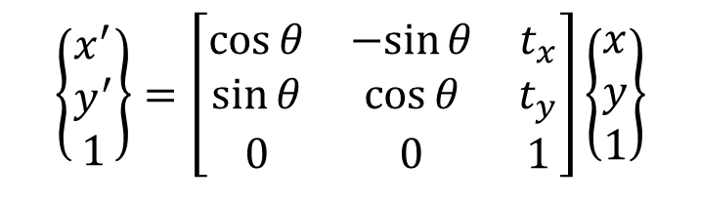
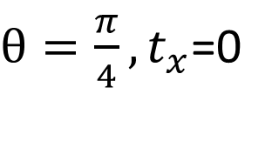
In Class - Rotate + Translate Square
$$\left\{\begin{matrix}x^{′} \\ y^{′} \\ 1\end{matrix}\right\}=\left[\begin{matrix}\cos{θ} & −sin{θ} & t_{x} \\ \sin{θ} & \cos{θ} & t_{y} \\ 0 & 0 & 1\end{matrix}\right]\left\{\begin{matrix}x \\ y \\ 1\end{matrix}\right\}$$
$θ=\frac{π}{4},t_{x}$=0

Slide 12
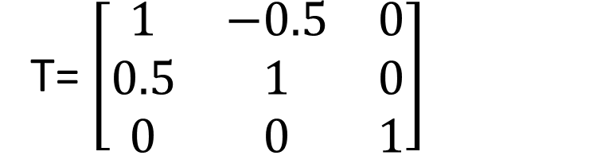
In Class – Draw the Result
T= $\left[\begin{matrix}1 & −0.5 & 0 \\ 0.5 & 1 & 0 \\ 0 & 0 & 1\end{matrix}\right]$

Slide 13
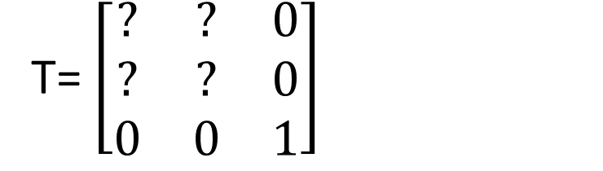
In Class – Find the Matrix which makes the figure look like
T= $\left[\begin{matrix}? & ? & 0 \\ ? & ? & 0 \\ 0 & 0 & 1\end{matrix}\right]$

Slide 14
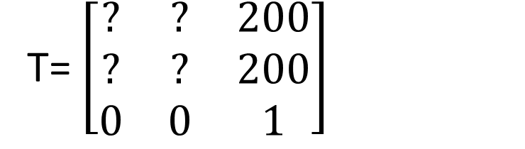
In Class – Find the Matrix which makes the figure look like
T= $\left[\begin{matrix}? & ? & 200 \\ ? & ? & 200 \\ 0 & 0 & 1\end{matrix}\right]$

Slide 15
In Class – Find the Matrix which makes the figure look like
T= $\left[\begin{matrix}? & ? & 200 \\ ? & ? & 200 \\ 0 & 0 & 1\end{matrix}\right]$

Slide 16
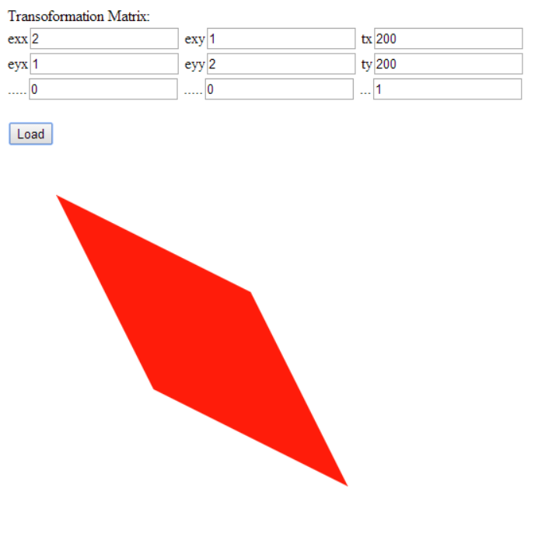
In Class – Check your results with the Starter Code
Hand in screen shots of the figures and the Matrix similar to above.

Slide 17
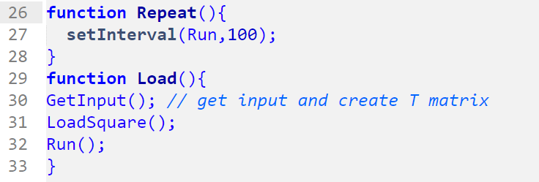
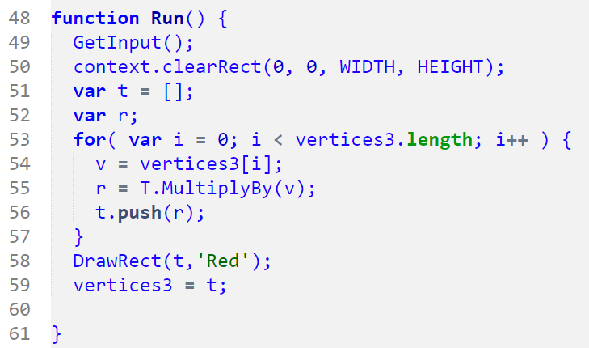
Animate Figure

Slide 18
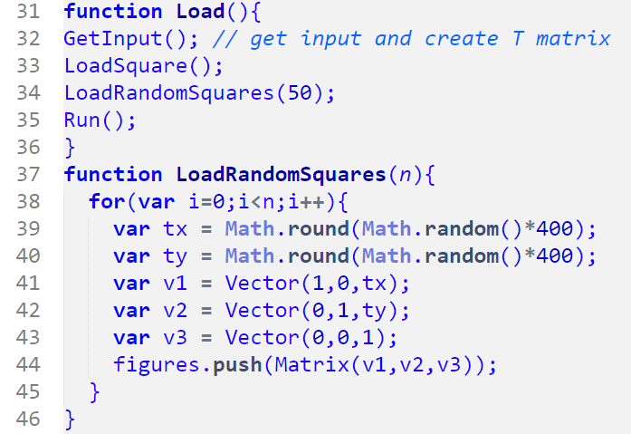
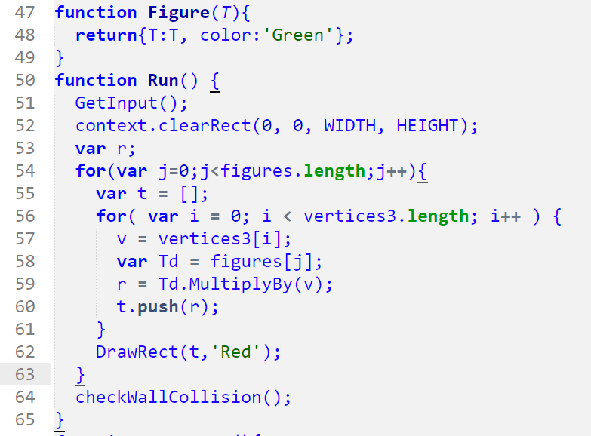

Slide 19
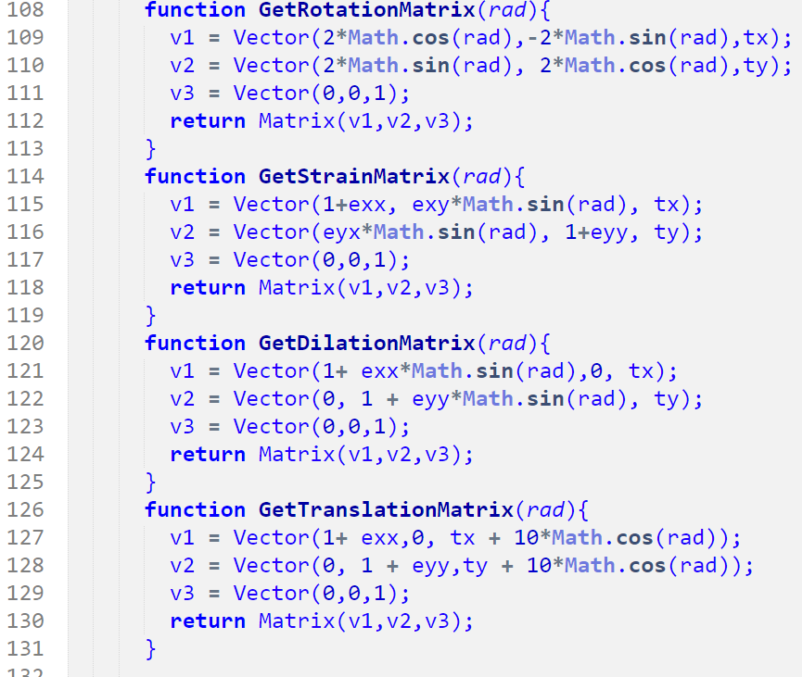
Animation Strategy

Slide 20
A Line is Defined by 2 Ordered Points
public Point[] points = new Point[2];

Slide 21
A Line is Defined by 2 Vectors
We take i and j as unit vectors

Slide 22
Normal to Line

Slide 23
Normal to Line

Slide 24
Perpendicular Distance from Origin to Line

Slide 25
Vector Equation of an Infinite Line
We know it is true for
the end points. It is true for any point r

Slide 26
Point to Line
Line through p parallel to given line

Slide 27
Parameterized Equation

Slide 28
Line-Line Intersection
http://local.wasp.uwa.edu.au/~pbourke/geometry/lineline2d/

Slide 29
Intersection Math
At the intersection point r1 = r2 →
This gives us 2 equations for the unknowns t1 and t2

Slide 30
Standard Form and Soln Using Determinants
Standard form

Slide 31
Intersection Point
The denominators for the equations for t1 and t2 are the same.
If the denominator for the equations for t1 and t2 is 0 then the two lines are parallel.
If the denominator and numerator for the equations for t1 and t2 are 0 then the two lines are coincident.

Slide 32
Solving by Elimination

Slide 33
Inside or Outside Polygon

Slide 34
Inside or Outside Polygon

Slide 35
Inside or Outside Polygon

Slide 36
Random Vector
10
10
10

Slide 37



